Slide 1

By Rogeshwaran
Business Analyst Career Program - Capstone Project

Slide 2


Content
01
About the project
02
Data-set Summary
03
Statistical Test
04
Data cleaning and Excel chart
05
Inserting Data into SQL
06
Importing data from SQL to Power BI
07
Power BI Dashboard
08
Insights and Questions
09
Conclusion

Slide 3
About the project
In this project, we will explore the various tools used in business analysis and gain a thorough understanding of the dataset provided by working with various tools to derive insights from the data.
We will also learn to import data into various software like Excel, SQL, and Power BI, perform data cleaning, and create dashboards in Power BI.

Slide 4
Data-set Summary
This dataset covers two financial years (2013-2014) and provides a comprehensive understanding of the products sold in different countries, the segments they belong to, the manufacturing costs, the number of units sold, the discounts offered, and the shipping dates.
It also includes the cost of goods sold, gross sales in different countries, and the profit earned. This information helps us understand the company's year-on-year growth rate, identify products with high demand in specific countries, and analyze profits.
This allows us to prepare stock in advance for high-demand countries, and make necessary improvements to optimize growth and efficiency.

Slide 5
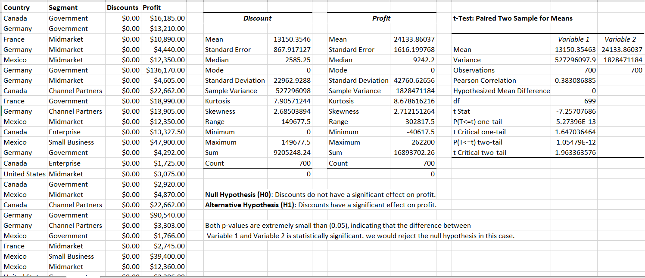
Statistical Test

Slide 6
Insert the given data into the SQL server
Insert the relevant screenshots verifying that the data is successfully inserted into a SQL DB. Run a basic Queries on Data.

Slide 7
Import the Data from the SQL Database into PowerBI
(This is a dummy “about us” section)
Insert the relevant screenshots verifying that the data is successfully inserted into PowerBI and do the required data cleaning or creation of measured for data analysis

Slide 8
Interactive Dashboard by using visualization tools
(This is a dummy “about us” section)
Insert the relevant screenshots of the Dashboard made using Visualization tools such as PowerBi , Make a beautiful Dashboard that shows visually appealing graphs and data analysis.

Slide 9
Conclusion and Inferences
(This is a dummy “about us” section)
Submit your conclusion and Inferences on Data after doing statistical and Graphical analysis using Excel and Visualization tools (PowerBI).

Slide 10
Endnotes
Reference Links:-
Insert related links for Excel file, PowerBI file

